Slide 1

Notes:
Introductions
Experience

Slide 2
Welcome to Culture Night!!!
We are excited to introduce Cascadia to you all!
Help yourself to food and drinks!
We want this to be fun!!!
We have raffles and games with prizes, so be ready to participate!

Slide 3

Let’s break the ice… Game 1: Musical Chairs
5 Players
Music plays, players walk
Music stops, players sit
Player without a chair is eliminated
Last player with a seat wins

Slide 4

Notes:
Introductions
Experience

Slide 5



The Cascadia “Family”
March 2015
October 2021
December 2025

Slide 6
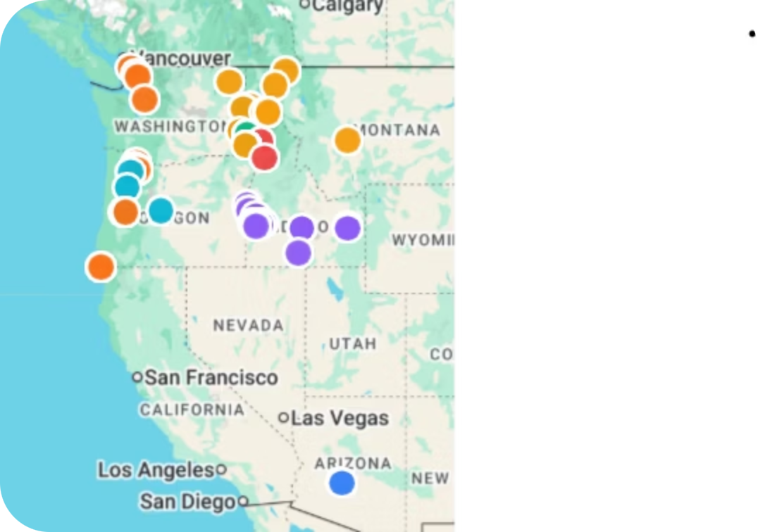
OUR GROWING FOOTPRINT
Skilled Nursing
48
Senior Living ALF/ILF
9
Home Health and Hospice
1
Dedicated Employees
3,500
Residents
4,000

Slide 7

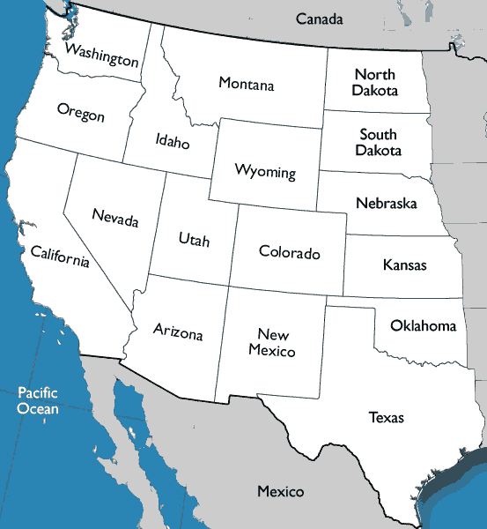




5 Healthcare Company Regions
Columbia (OR, Western WA)
Northern (Eastern WA, Northern ID, MT)
3 Rivers (Central - ID)
Envision (Southern – ID)
Vincero (AZ)

Slide 8
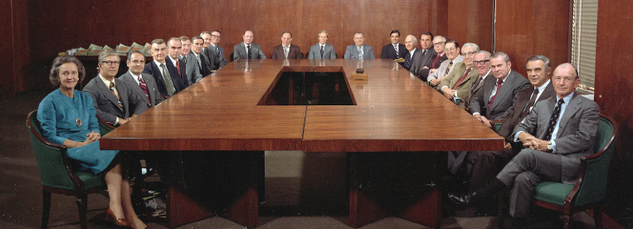
WE ARE NOT CORPORATE!
Notes:
Many different ways to structure a company many historically look like this.
We don't we are a flat line organization
We are all partners with different sets of skills
We learn and grow from all of our partners in contrast to one regional president
We encourage one another to be vulnerable and to also speak up

Slide 9
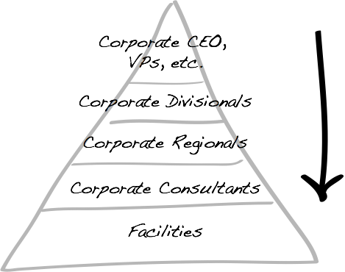
The Common Way…
Notes:
Many different ways to structure a company many historically look like this.
We don't we are a flat line organization
We are all partners with different sets of skills
We learn and grow from all of our partners in contrast to one regional president
We encourage one another to be vulnerable and to also speak up

Slide 10

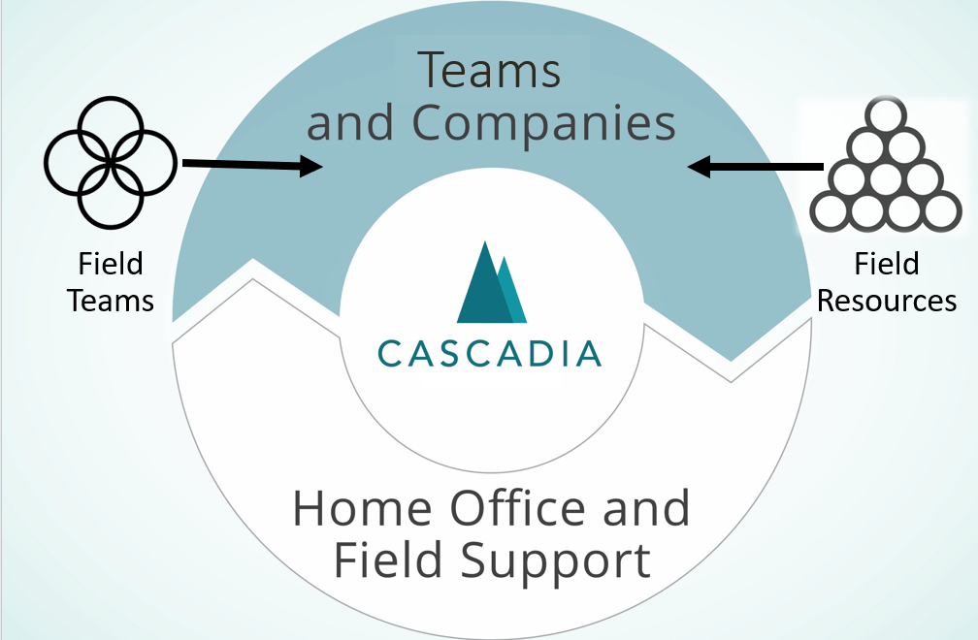

The Cascadia Way…
Field
Teams
Field
Resources
Notes:
Each facility is in a Team of 3 or 4 other facilities to partner with the expectation that they collaborate often and hold each other accountable
The Home office is a service center designed to serve, support and inspire the field.

Slide 11

RAFFLE

Slide 12


Slide 13

FAMILY
Notes:
Building strong connections at home, work, and in the community

Slide 14

Challenge 1: Cookie

Slide 15
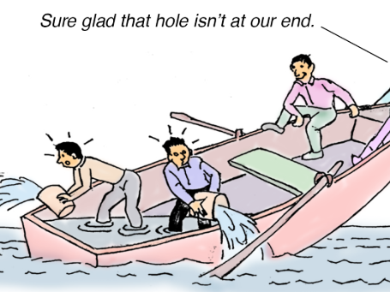
OWNERSHIP
Notes:
Taking accountability for one's work, care, and interactions

Slide 16
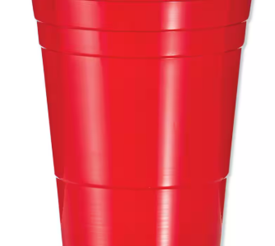
Challenge 2: Cup Stacking

Slide 17

RESPONSIBILITY
Notes:
Upholding ethics, providing excellent care, and building a strong culture.

Slide 18
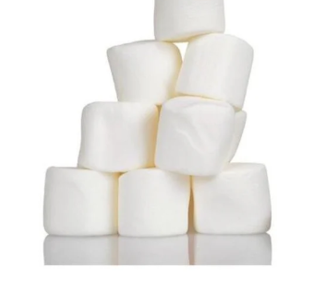
Challenge 3: Marshmellows

Slide 19
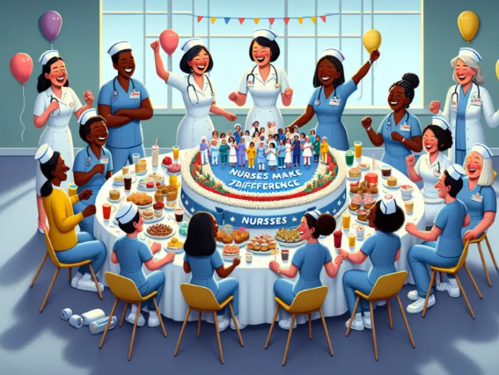
CELEBRATION
Notes:
Honoring life stories and small accomplishments.

Slide 20

Challenge 4: Pencils

Slide 21

EXPERIENCE
Notes:
Creating and nurturing meaningful experiences

Slide 22

Challenge 5: Flip Cup

Slide 23
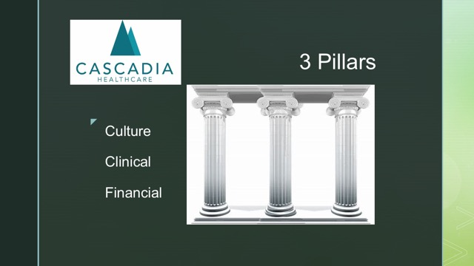
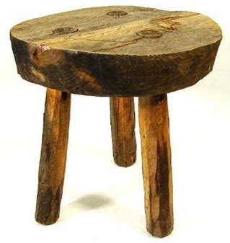

3 Pillars
Clinical – Cultural - Financial

Slide 24
RAFFLE

Slide 25


